Slide 1
Phishing attacks
By : Yara Ahmed swaisa

Slide 2
CONTENTS OF THIS PRESENTATION:
Identifying and Preventing Phishing Attacks
The Phishing Lifecycle
Recognizing Phishing Emails
Phishing Websites
Social Engineering Tactics
Best Practices to Avoid Phishing
Reporting and Responding to Phishing
The Business Impact of Phishing
Resources

Slide 3
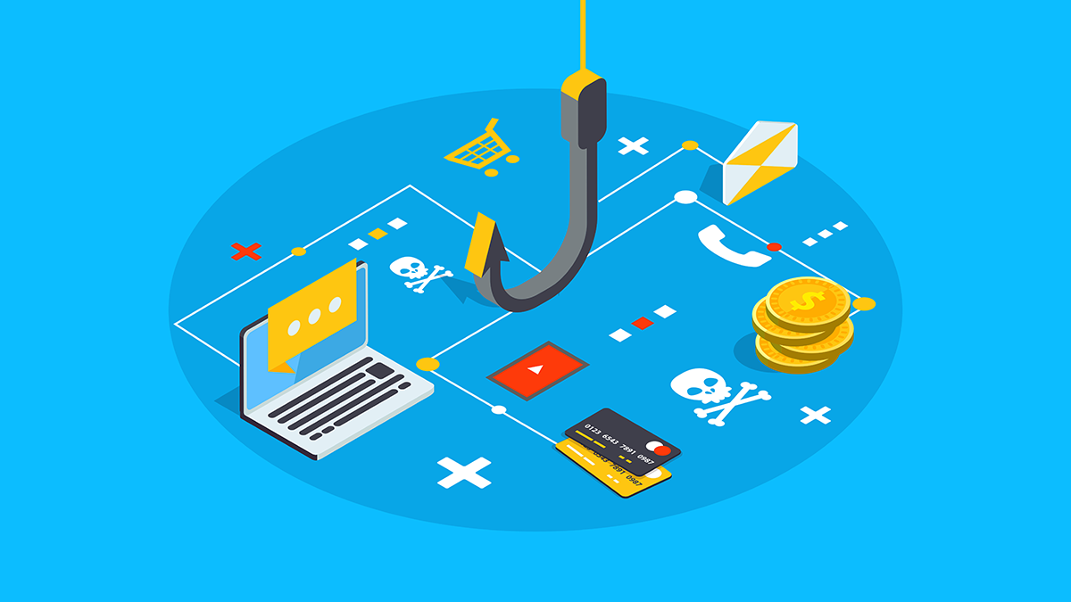
01
Identifying and Preventing Phishing Attacks

Slide 4
What is Phishing?
Definition: Phishing is a type of social engineering attack where cybercriminals try to trick you into revealing sensitive information or performing an action that compromises your security.
This is typically done through deceptive emails, websites, or social media messages.

Slide 5
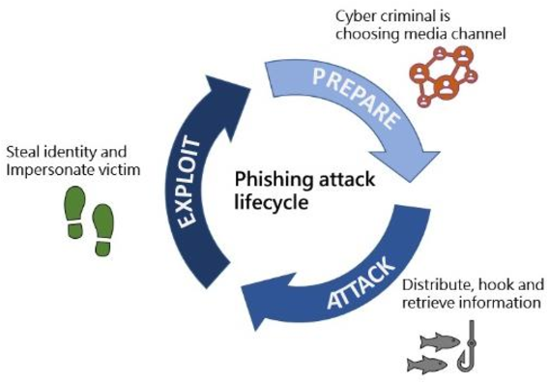
02
The Phishing Lifecycle

Slide 6
The Phishing Lifecycle:
Attacker creates a phishing message or website.
Victim receives the phishing attempt.
Victim is fooled into providing sensitive data or downloading malware.
Attacker can then steal the victim's identity, money, or access other accounts.

Slide 7
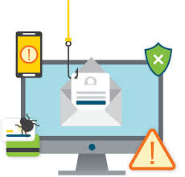
03
Recognizing Phishing Emails

Slide 8
Recognizing Phishing Emails:
Inspect the sender's email address
Look for misspellings or unusual domains
Beware of generic greetings like "Dear customer“
Check for urgent or threatening language
Look for poor grammar, spelling, and formatting
Hover over links to see the actual URL before clicking

Slide 9
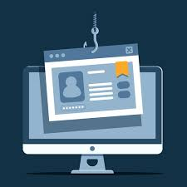
04
Phishing Websites

Slide 10
Phishing Websites:
Phishing sites often use domain names similar to legitimate sites
Look for the padlock icon and "https://" - this indicates a secure connection
Carefully inspect the website for signs of forgery like missing logos

Slide 11
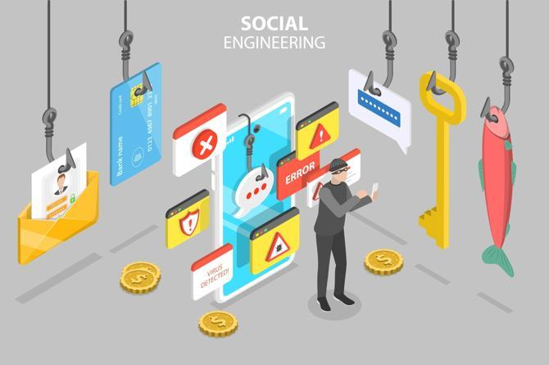
05
Social Engineering Tactics

Slide 12
Social Engineering Tactics:
Beware of unsolicited requests for personal information or login credentials
Don't accept friend requests or messages from strangers on social media
Be cautious of urgent pleas to send money or gift cards

Slide 13
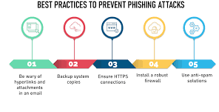
06
Best Practices to Avoid Phishing

Slide 14
Best Practices to Avoid Phishing:
Never click links or open attachments in emails from unknown senders
Verify the source of any request for sensitive information
Use strong, unique passwords and enable two-factor authentication
Keep software and antivirus protection up-to-date
Be skeptical and trust your instincts if something seems suspicious

Slide 15
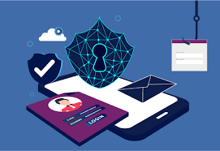
07
Reporting and Responding to Phishing

Slide 16
Reporting and Responding to Phishing:
Reporting Phishing Attempts
Report any suspected phishing to your organization's IT department
Do not respond to or engage with phishing messages
Responding to a Phishing Compromise
If you've provided sensitive information, take steps to secure your accounts
Monitor your accounts and financial statements for any suspicious activity

Slide 17
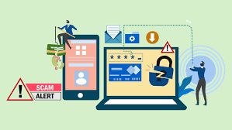
08
The Business Impact of Phishing

Slide 18
The Business Impact of Phishing:
Financial losses
Reputational damage
Productivity impacts

Slide 19
RESOURCES
https://www.researchgate.net/publication/329716781_Study_on_Phishing_Attacks
https://www.frontiersin.org/articles/10.3389/fcomp.2021.563060/full
https://ieeexplore.ieee.org/document/9396693

Slide 20
THANKS!

